Slide 1
程序设计原理
程序设计概述和c++基础知识
任课教师： 喻 梅
于瑞国
王建荣
李雪威
赵满坤

Slide 2
课程目标
掌握结构化程序设计方法；选择合适的开发环境、工具，并能熟练使用该工具完成程序设计工作；培养学生的逻辑思维能力，培养其严谨的思维方式和良好的程序设计风格。
不仅是一门程序设计语言课程
思维课程：培养逻辑思维能力
以C++程序设计语言为例，培养逻辑思维能力

Slide 3
学习方法
实践、实践、再实践，实践是检验真理的唯一标准
纸上学来终觉浅，绝知此事要躬行
纵使思忖千百度，不如亲手下地锄
雄关漫道真如铁，而今迈步从头越
有天赋的不要骄傲，可以适度帮助同学
没有天赋的不要怕、不要怨、不要愁，踏踏实实，勤勤恳恳，任劳任怨、归根到底一个字就是：练！

Slide 4
C++ Development Tools
For Windows
  CodeBlocks
  Dev-C++
  VS Code
  For Linux
  CodeBlocks
  Homework：Download the software and install it.
  Notes: There are serval different versions of these software on the site. You may choose which version is best for you.

Slide 5
Framework of C++ Program
#include <iostream>
using namespace std;
/*This is my first program! It's too simple , but I hate you .You make me so busy and crazy !*/
int main()
{
cout << “Welcome to C++!” << endl; //comments bala bala
cout << "Welcome to Zhisuan!" << endl;
cout << “Welcome to Tianjin University！" << endl;
return 0;
}

Slide 6
Exercise
Write a program which prints "Hello World" to standard output.
Input
There is no input for this problem.
Output
Print "Hello World" in a line.
Sample Input 1
No input
Sample Output 1
Hello World

Slide 7
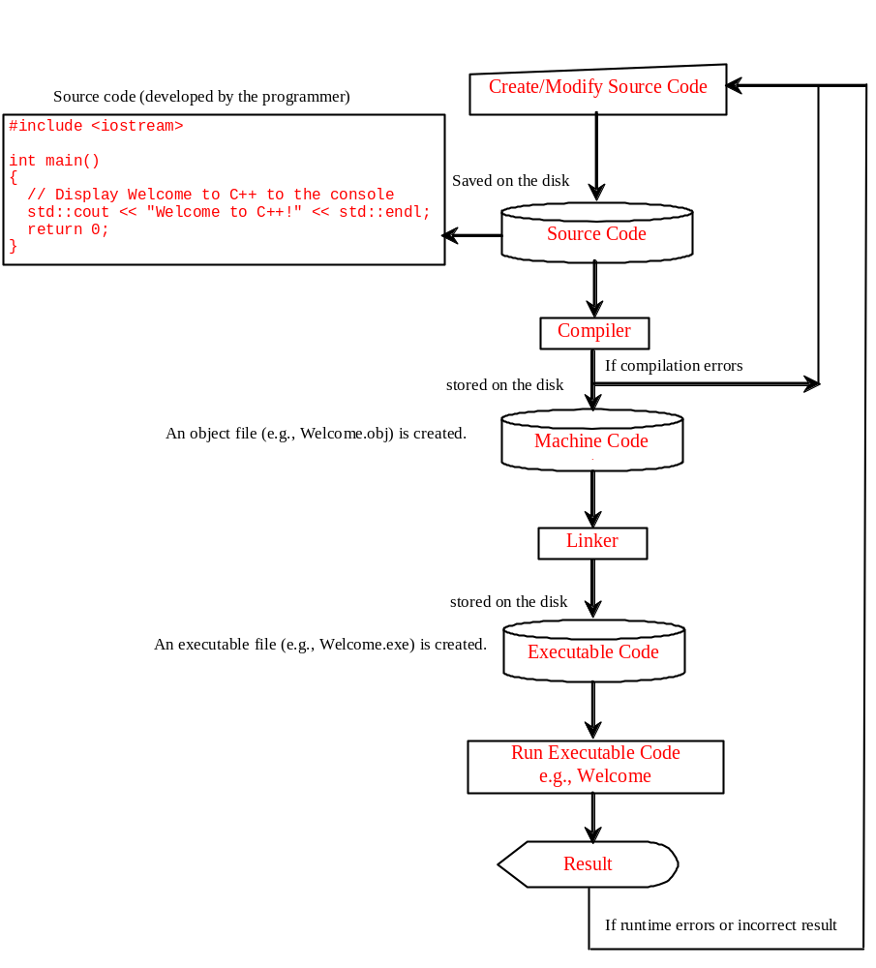
Program running process
Creating, Compiling, and Running Programs

Slide 8
Programming Style and Documentation
Appropriate Comments and Comment Styles
Proper Indentation and Spacing
#include <iostream>
using namespace std;
/*This program preform mathematical computation and display the result on the console.*/
int main()
{
cout << "(10.5 + 2 * 3) / (45 - 3.5) = ";
cout << (10.5 + 2 * 3) / (45 - 3.5) << endl;
return 0;
}

Slide 9
Identifiers
An identifier is a sequence of characters that consists of letters, digits, and underscores (_).
An identifier must start with a letter or an underscore. It cannot start with a digit.
An identifier cannot be a reserved word.
An identifier can be of any length, but your C++ compiler may impose some restriction. Use identifiers of 31 characters or fewer to ensure portability.

Slide 10
Declaring Variables
int x,y; // Declare x,y to be
// integer variables;
double radius; // Declare radius to
// be a double variable;
char a; // Declare a to be a
// character variable;

Slide 11
Assignment Statements
x = 1; // Assign 1 to x;
y = 2; // Assign 2 to y;
radius = 1.0; // Assign 1.0 to radius;
a = 'A'; // Assign 'A' to a;
x = y + 1;
//Assign the addition of y and 1 to x;
x = x +1;
int a = 1;
double d = 1.4;

Slide 12
Standard output and input
cout
cin
#include <iostream>
using namespace std;
int main()
{
int a = 10;
double r = 2.0;
int s = 32767;
cout << s << endl;
cout << r * r << endl;
return 0;
}
#include <iostream>
using namespace std;
int main()
{
double r = 2.0;
int s = 32767;
cin >> s >> r;
cout << s << endl;
cout << r * r << endl;
return 0;
}

Slide 13
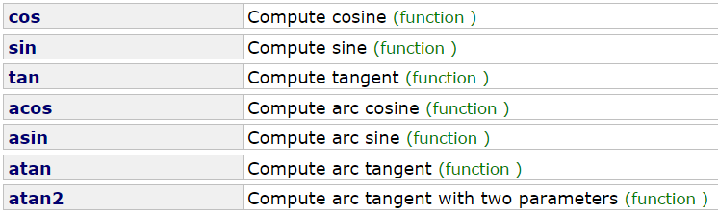
Mathematical Functions
Trigonometric Functions
sin(0) returns 0.0
sin(270 * PI/180) returns -1.0
sin(PI / 6) returns 0.5
cos(PI / 6) returns 0.866
asin(0.5) returns 0.523599(PI/6)

Slide 14
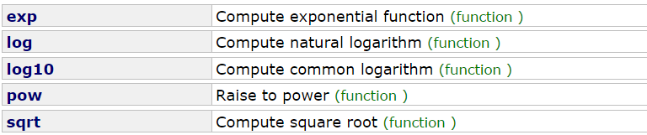
Mathematical Functions
Exponent Functions
exp(1.0) returns 2.71828
log(E) returns 1.0
log10(10.0) returns 1.0
pow(2.0,3) returns 8.0
sqrt(4.0) returns 2.0

Slide 15

Mathematical Functions
Rounding Function
double ceil (double x);
ceil of 2.3 is 3.0
ceil of 3.8 is 4.0
ceil of -2.3 is -2.0
ceil of -3.8 is -3.0
double floor (double x);
floor of 2.3 is 2.0
floor of 3.8 is 3.0
floor of -2.3 is -3.0
floor of -3.8 is -4.0
double fmod (double numer , double denom);
fmod of 5.3 / 2 is 1.300000
fmod of 18.5 / 4.2 is 1.700000

Slide 16
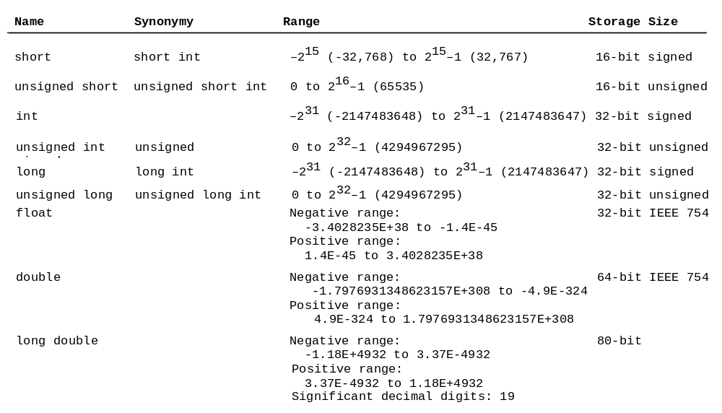
Numerical Data Types and Operations

